Slide 1
Secure Web Programming (TLEN 5839) Bank application System
- Vaishnavi Viswanathan

Slide 2
Application Users
Bank Admin
They are the ones who can create new accounts.
Only the admin has the access privilege to login into the database and view all the existing accounts and their details.
They also have the privilege to delete an account in case of reported fraud theft.
Bank account holders
Those who have an account in this bank can login and view their account balances,
make transfers to different accounts within the bank and
view their bank statements.

Slide 3
Application usage
Admin
Admin logs into the system.
After the admin creates an account for a customer, the details of the customer will be included in the database and he will be able to login into his account.
Once a theft is reported, the admin deletes the account holder’s information along with his credit card details by using his SSN number.
Customers/Account Holders
- After a user logs into the system he will be directed to the default tab Accounts page which displays his account details with balances.
- The Transfers tab provides amount transfer feature. User can transfer cash between different accounts within the bank (Form validation is done for this functionality).
The Statements tab displays the details about each transfer that the customers make.
System
It keep records of IP addresses that tries to login and blocks an unauthorized user after 5 failed attempts.
It automatically updates the balances of accounts involved in a transaction.

Slide 4
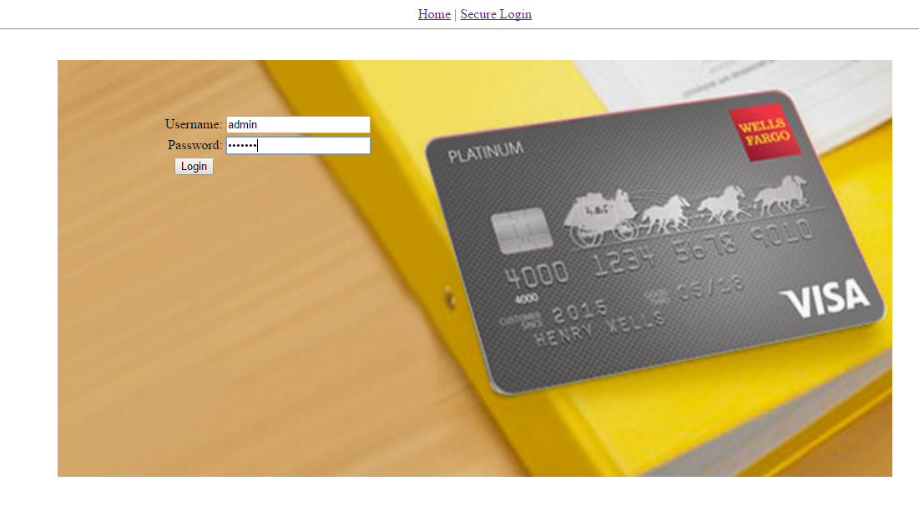
Admin functionalities – Login page

Slide 5
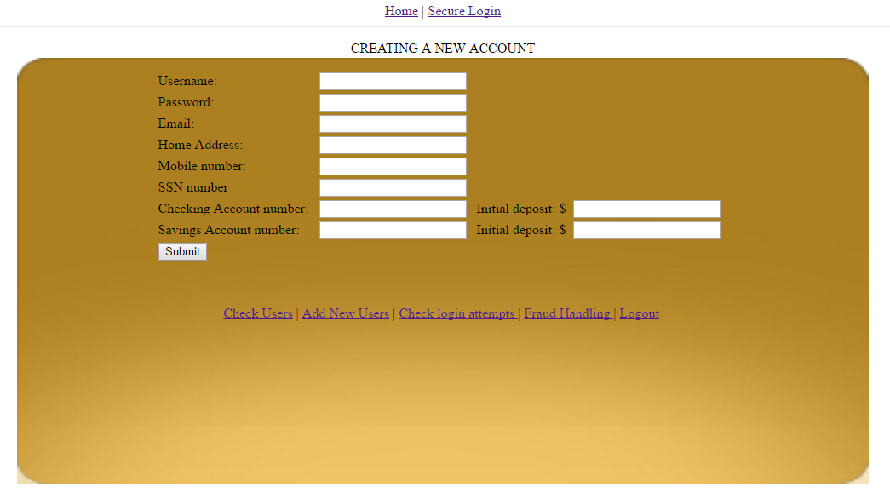
Admin functionalities – Account Creation page

Slide 6
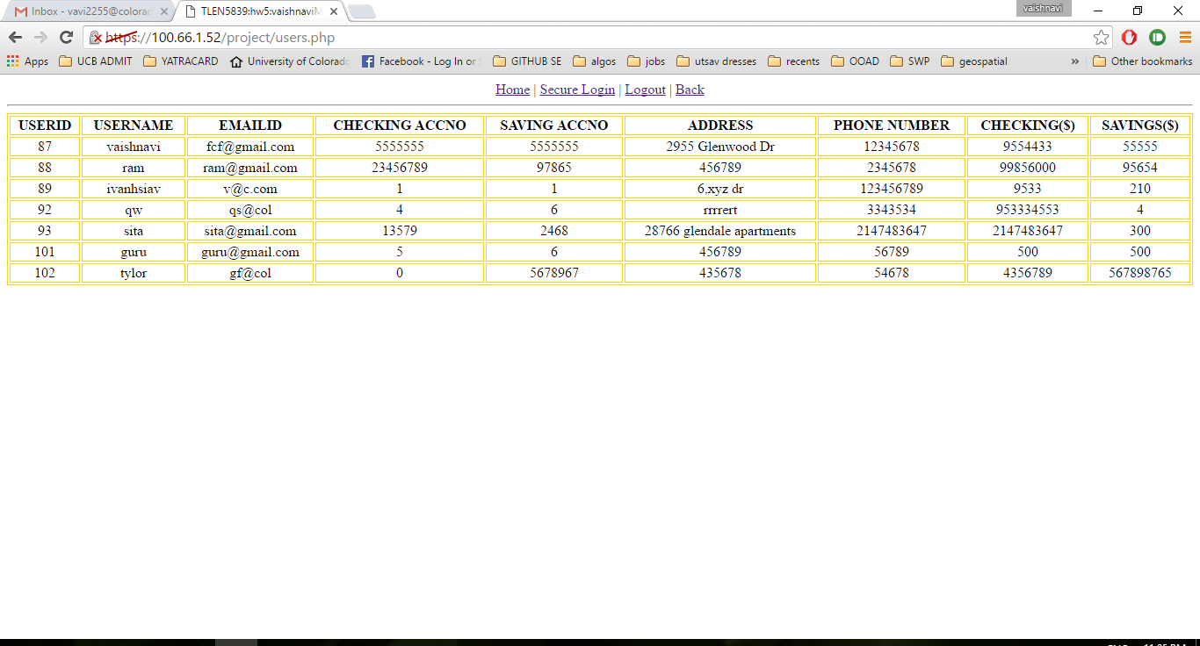
Admin functionalities Viewing account holders of the bank

Slide 7
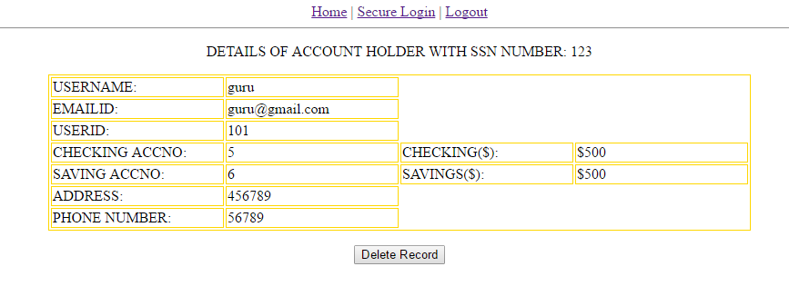
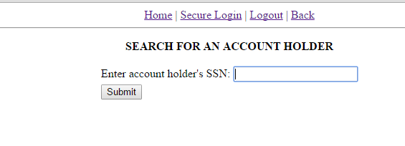
Admin functionalities - Deleting an account in case of reported frauds

Slide 8
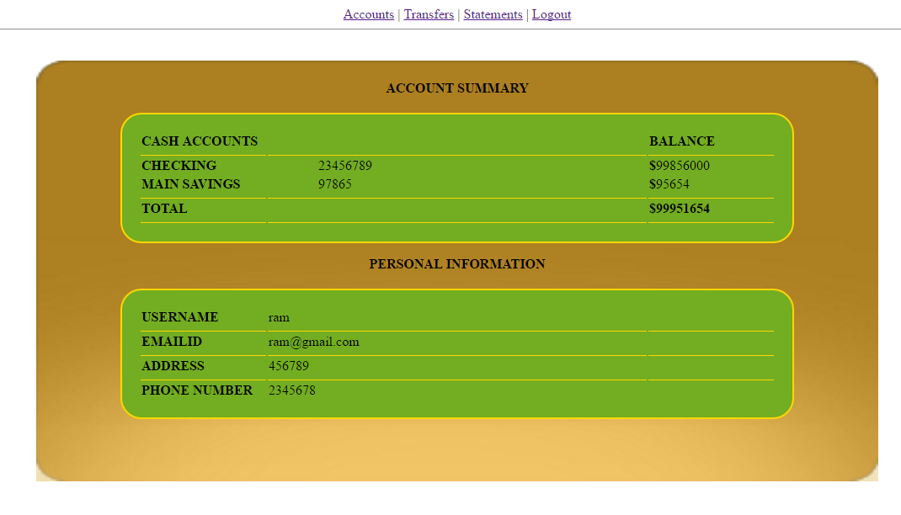
Customer functionalities – Check Balances

Slide 9
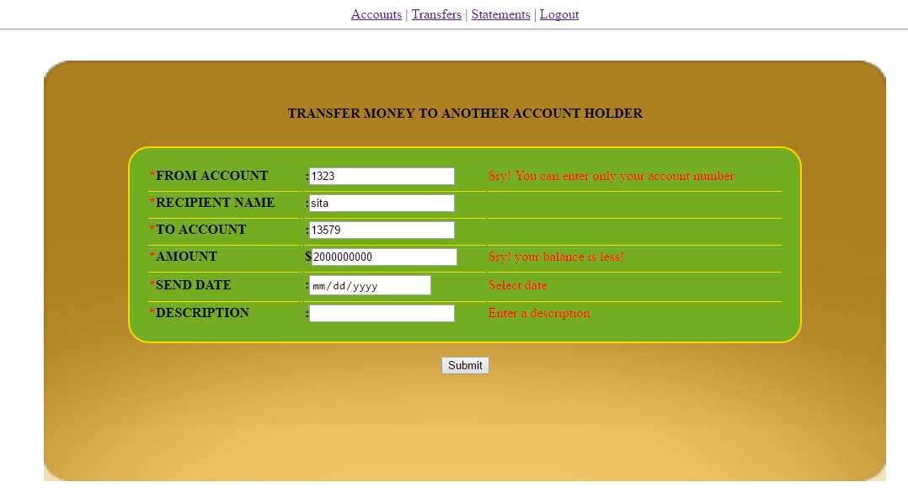
Customer functionalities – Make Transfers (Form is validated before a transfer is made)

Slide 10
Customer functionalities – Make Transfers (Form is validated before a transfer is made)
Validations made – The form throws an error if
From Account: If it does not match the account number of the user who has logged in.
To Account: If it does not match to an existing account holder of the bank.
Receiver name: The To account entry and the corresponding receiver name should match.
Amount : Amount entered should be less than the available balance.
Date, Description, From account, To Account, Receiver name and the amount - are all required fields and they cannot be empty.
It also throws an error if the From Account, To Account and Amount has alphabets instead of numbers in them.
Also, the receiver name field should not contain numbers.

Slide 11
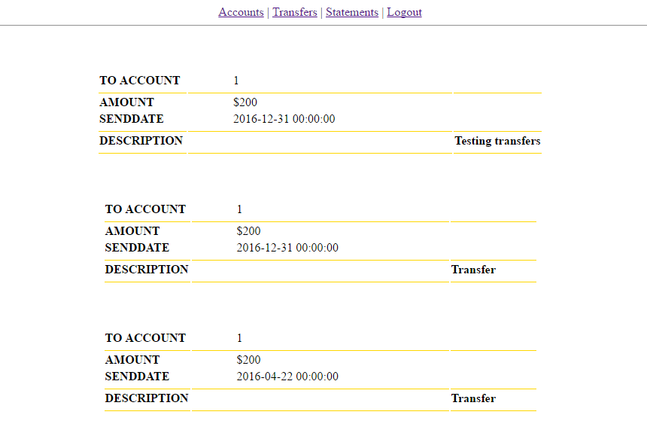
Customer functionalities – Statements tab

Slide 12
Thankyou! ☺

